Slide 1
Bedford Youth Soccer
Travel Coaches Meeting Fall 2021
3rd-8th Grade

Slide 2
Agenda
Mission of Bedford Youth Soccer
COVID 19 Impacts
Important Websites
Referees
Zero Tolerance Policy
Games/Schedules
Practice Format
Medical Forms
Adult Registration and CORI Process
Fields
Travel Field Assignments
Coaching Resources

Slide 3
Mission of Bedford Youth Soccer
Bedford Soccer's mission is to serve the children and achieve these goals:
1. All children can play. We provide opportunities for children of all skill levels to learn and
play the game.
2. Fun, learning, enjoyment. Having fun, learning and enjoying the game are always more
important than winning.
3. The game is the best teacher. Effective practice combines age-appropriate skill
development with time spent playing the game.
4. Sportsmanship and teamwork. Learning and demonstrating excellent sportsmanship and
teamwork are key parts of learning soccer.
5. Positive coaching. Coaching must always be positive, supporting children's enjoyment of
the game, strengthening children's self esteem and creating a positive environment.
6. Positive spectatorship. Parents and spectators play a crucial role in providing a positive
experience for the children. Positive spectators show respect for and appreciation of the
game, the coaches, and the players on all teams.

Slide 4
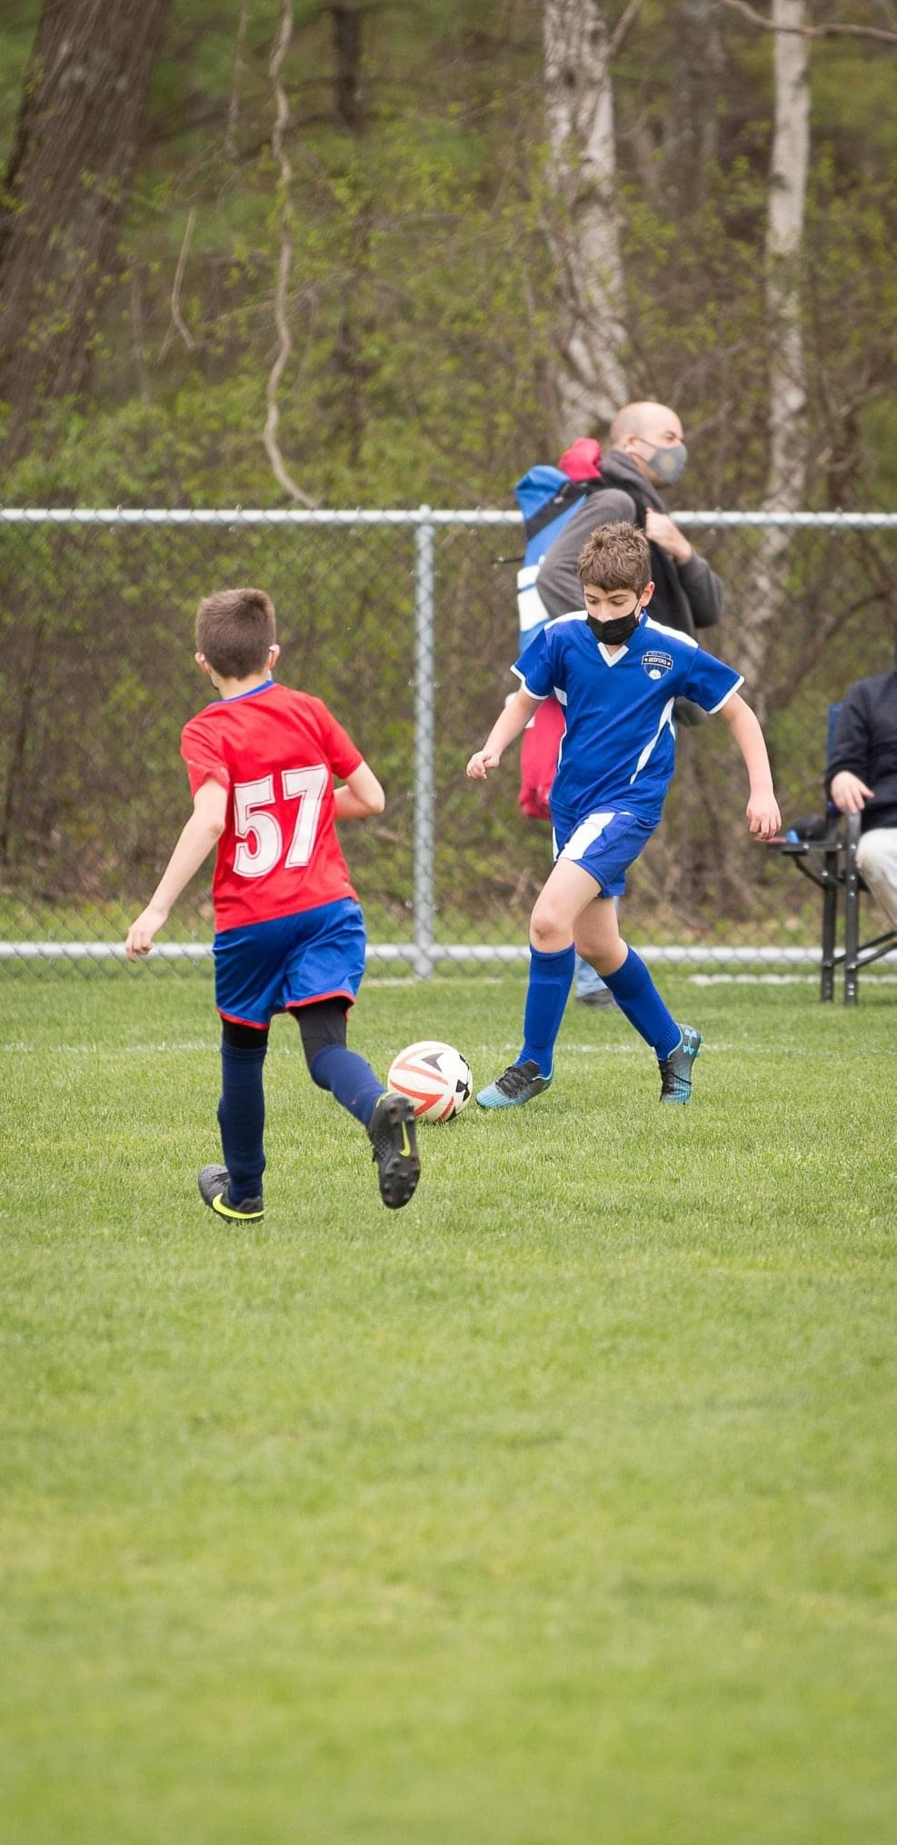
COVID-19 Impacts
Currently, there are no state mandated COVID-19 restrictions for Soccer.
Players are not required to wear masks but they may choose to.
MYSA is currently recommending that coaches and spectators wear masks.
Additional cleaning supplies and hand sanitizer will be given to each team with additional supplies available upon request.
We ask that coaches sanitize all shared equipment (balls, cones, etc.) often.
We ask that you minimize team huddles and discourage close contact on sidelines, high fives, fist bumps and hand shakes, and sharing water and food.
Each player will receive a pinnie that they can keep. We will not collect these pinnies at the end of the season.

Slide 5
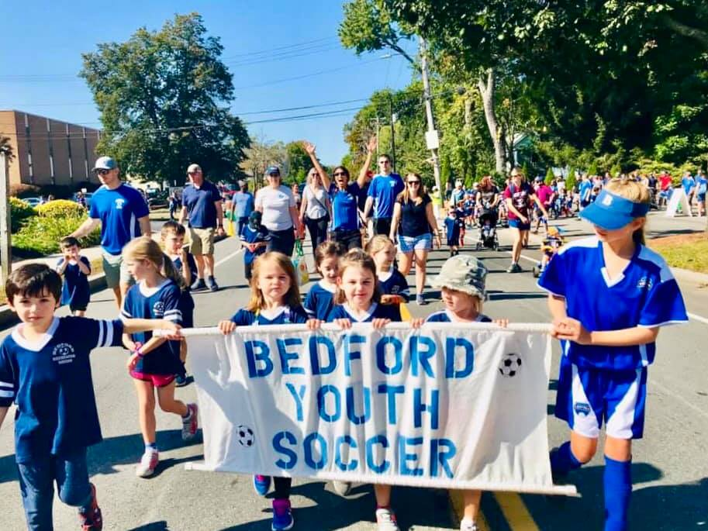
Current Rule book
Bedford Youth
Soccer Website
www.bedfordyouthsoccer.org
BAYS Website
www.bays.org
https://bays.org/book/playing-rules-and-regulations-bays-soccer-competition

Slide 6
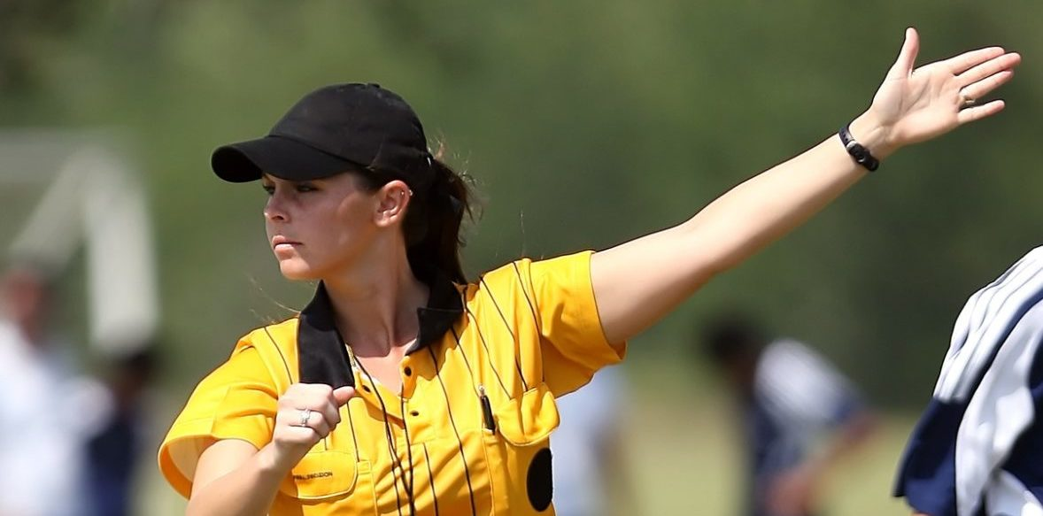
Referees
The referee coordinator is Bob Goodman
Bob is responsible for the training, coordination and scheduling of referees.
If there is an issue concerning a referee you should be reaching out to Bob.
How to confirm your referee?
For home games, Head Coaches should be reaching out to their scheduled referee a few days before the game to confirm that they are aware of the game. If an issue arises that will give us time to trouble shoot.
If your game is cancelled you MUST let your referee know AND confirm that they have received the message. Please ask for confirmation.
Referees are often young and learning too, they are your neighbors! Please be kind and helpful to them whenever possible. A referee shortage is not a problem that we want.
Manage your parents and let them know the expectations from the start. Do not allow parents to harass or talk to the referees. If there is a pattern please contact Nikki so she can handle it.
Zero tolerance violations often have consequences that range from apology letters to suspension of games. Bedford aims to have ZERO Zero Tolerance Violations from both parents, coaches and players.

Slide 7
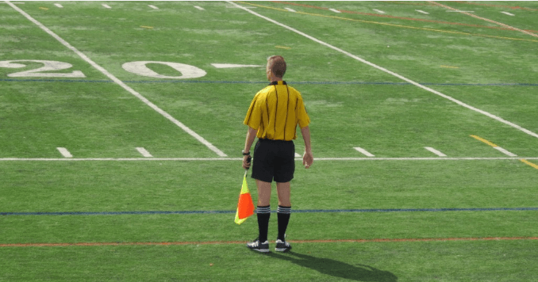
Zero tolerance policy
ZERO TOLERANCE POLICY:
All individuals responsible for a team and all spectators shall support the referee. Failure to do so will undermine the referee’s authority and has the potential of creating a hostile environment for the players, the referee, and all the other participants and spectators.
Consequently, BAYS has adopted and modified the following rules:
No one, except the players, is to speak to the referee during or after the game. Exceptions: Coaches may ask questions before the game, call for substitutions and point out emergencies during the game, or respond to the referee if addressed.
Absolutely no disputing calls, during or after the game, no remarks to the referee to watch certain players or attend to rough play. NO YELLING at the referee, EVER, and no criticism, sarcasm, harassment, intimidation, or feedback of any kind during or after the game.
Violators may be ejected and are subject to disciplinary action by the BAYS Sportsmanship Review Committee.
If coaches or spectators have questions regarding particular calls, rules, or a referee, or wish to give feedback regarding a referee, please contact the town soccer club referee’s coordinator for the game in question, or contact the BAYS Referees Representative at http://www.bays.org

Slide 8
Games
Games begin on Saturday, September 11.
We are unapologetic about maintaining equal playing time in all positions, even goal. We are a town program, not a club program. We can play to win without sacrificing those principals
Fun: the top reason that kids stop playing is lack of fun
Match Day Check List
Referee
Corner Flags
Goals
Inspect the field conditions
Rosters-2 official copies for each game. Official BAYS roster (different from roster announcement) will be emailed to you. Print a bunch of copies for your bag.
Reporting results: Report your results to your BAYS section leader after your game. This is important so records are accurate, especially for misplaced teams.
Misplaced teams: If you are overwhelmed or overwhelming there is a possibility of moving after week 5. We will monitor. Talk to your AGC.
No heading for anyone except grades 7/8
BAYS guidelines for goal differential
Max goal differential of 5 there is a good presentation on the BAYS website on how to manage. If you are not managing this we will hear about it.

Slide 9
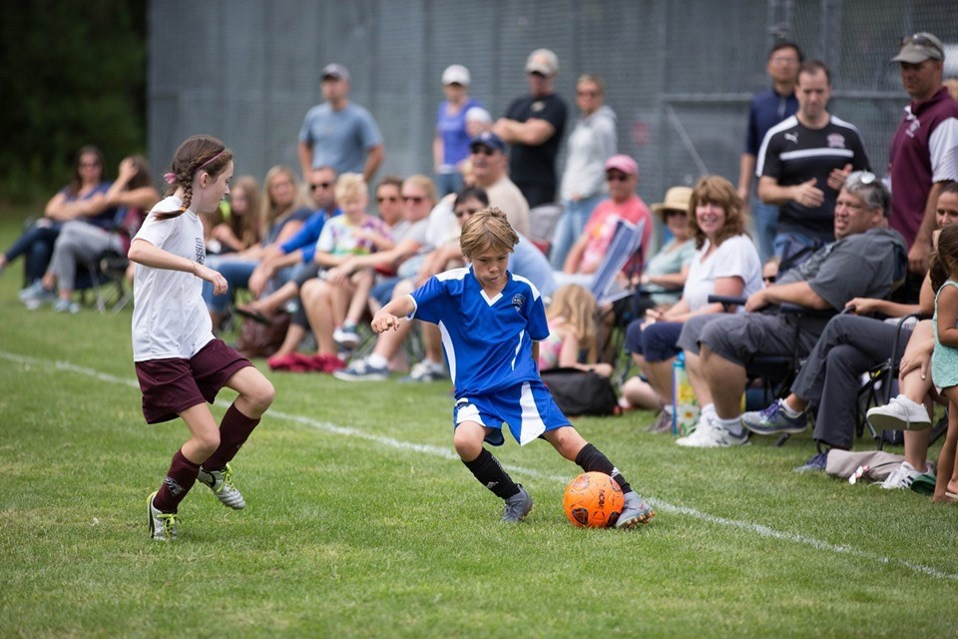
How do I access my team’s schedule?
You can access your schedule this way:
Or this way…
Step 1: www.bays.org
Step 2: Current Season
Step 3: Schedule
Step 4: Chose the following for your team:
Season
Gender
Grade
Division
Home Section
Week
Step 1: www.bays.org
Step 2: Current Season
Step 3: Teams/Games/Standings by town
Step 4: Chose Bedford Youth Soccer
Step 5: Chose your team
You can sync your game schedule to your calendar.

Slide 10
Official BAYS Roster
Your team received a “roster announcement” from the Recreation Department. This is NOT your official BAYS Roster. It is just used for informational purposes.
Official BAYS Rosters will be generated by the Bedford Registrar (Nikki Taylor) and will be submitted to the league for approval.
Once the roster is approved by the league it will be emailed to you from Nikki. This roster contains all players and properly-credentialed coaches.
Coaches are required to bring two PAPER copies of this roster to each game. One copy will go to your opponent and one copy will go to your opponent.
Your team will not be permitted to play without copies of this roster. Additionally, coaches not listed on the roster are not permitted to be on the sideline.
Only 4 coaches are eligible to be listed on each roster and only 3 coaches are allowed on the sideline of each game.

Slide 11
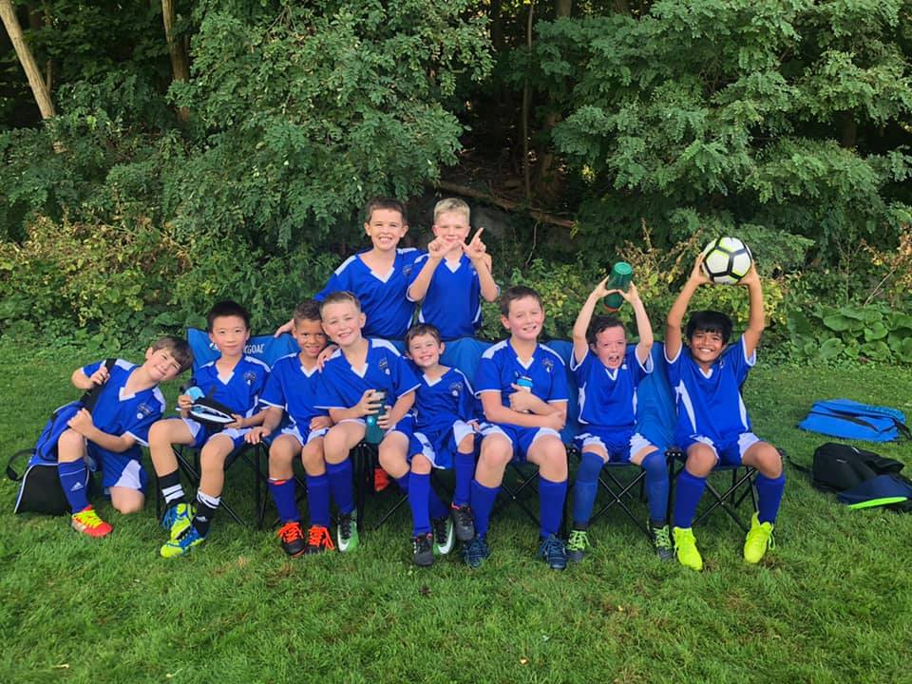
games
Please Do:
Contact your opposing team’s coach by Wednesday before game
Verify your referee is coming to the game by Wednesday before the game
Verify your team’s availability for games over Bedford Day and Indigenous People’s Day Weekend
Pre-pone games if you will not have enough players
Communication with parents throughout the season is key.
Attitude: players follow the coaches example when it comes to attitude
Take care of the fields. Move the goals out of the goal mouths for practices.
Players may not wear jewelry
Weather cancellation:
By 7:00 AM (morning sessions)
By 11:00 AM (afternoon sessions)
If there is a weather cancellation it is the coaches responsibility to notify their players.

Slide 12
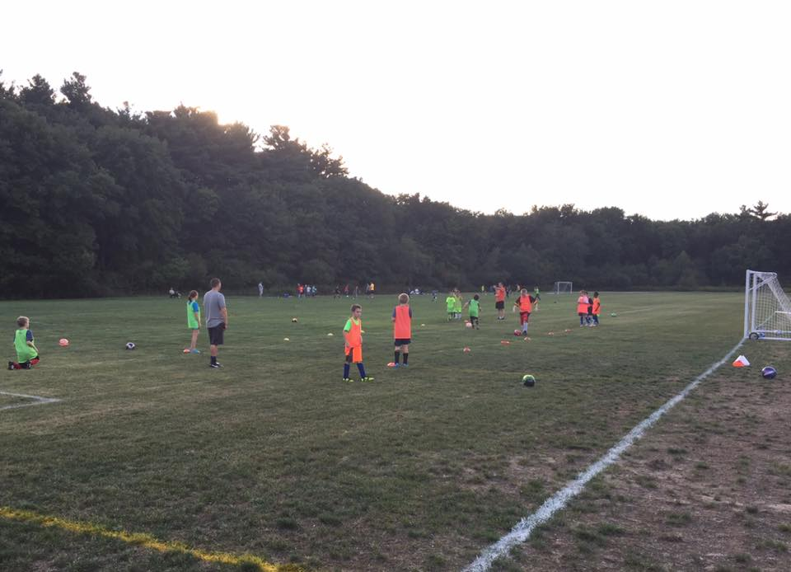
General Soccer Practice format
10 minutes before session start
Coaches arrive and setup kid belongings area and any drills
Players may not be dropped off early!
5 minutes before session start
Players begin to arrive
Coach greets each player, verbally verifies no symptoms and assigns the kid to an area for that belongings
Session start
Start drills / practice portion of session
40-60 minutes after session start
Start games / scrimmage
Session end time
Players leave field immediately – absolutely no “extra” shots/practice/mingling
Coaches only collect all equipment
10 minutes after session end time
Coaches leave field

Slide 13
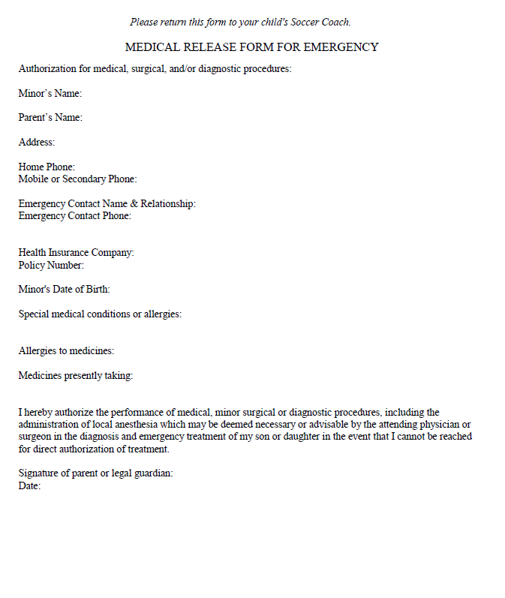
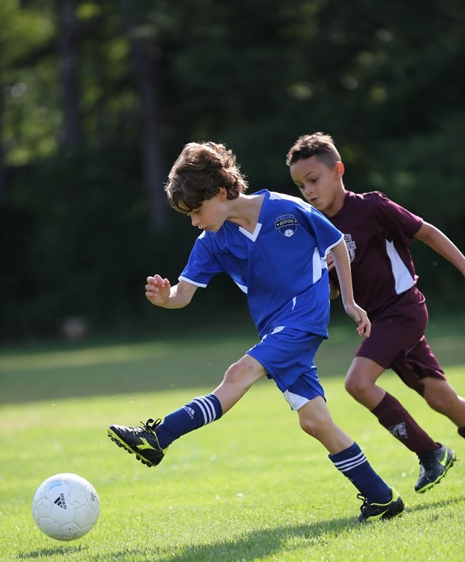
Medical form
*Coaches keep forms in their team bag all season.
Forms will be emailed to parents before the start of the season.
This form will also include a zero tolerance pledge.

Slide 14
Adult registration/cori process
MYSA Cori process has been emailed to all coaches.
Coaches who have not completed all requirements will not be able to attend any practices until they are cleared by Nikki.
We will not be able to add your team roster until you have completed the process.
CREDENTIALS- If you have completed all requirements your coach credential will be in your team bag by equipment pick up. If you still have things to complete we will need to schedule a time for you to pick it up once you are completed.
Please contact Nikki with any questions.

Slide 15
fields
Protect our fields
Move goals for practices to avoid wear and tear to the goal mouths
Moving the goals out of the goal mouths will also help the Public Works department mow inside of the goals
Make sure the goals are anchored
Avoid wet areas, damage to the field takes longer to fix than it does to create
If you notice an issue with a field or goal please let Nikki know as soon as possible so she can address it.

Slide 16
Travel Field assignments
Grades 3-8
Two practices per week and one game per weekend
Games Begin September 11 and end November 13
Girls Practice Monday/Thursday
Boys Practice Tuesday/Friday
Age Group | Practice Location | Games
Boys Grade 3-Gallant | Liljegren Field | Springs Brook Park
Boys Grade 3-Hadden | Liljegren Field | Springs Brook Park
Boys Grade 3-Iandiorio | Liljegren Field | Lane School Soccer
Boys Grade 4-Carroll | Lane School | Lane School Soccer
Boys Grade 4-Kresser | South Road 7v7 Near Houses | Lane School Soccer
Boys Grade 6-Parmentier | South Road Back | South Road Back
Boys Grade 6- Kaw | South Road Back | South Road Back
Boys Grade 6-TBD | South Road Front | South Road Front
Boys Grade 8-Kruger | BHS Turf/Wilson Field | BHS Turf/Wilson Field
Boys Grade 8-Rotella | BHS Turf/Wilson Field | BHS Turf/Wilson Field
Age Group | Practice Location | Games
Girls Grade 3-Lyons | Lane School Soccer | Lane School Soccer
Girls Grade 3-Toth | South Road (7v7) Near Houses | Lane School Soccer
Girls Grade 4-Nair | Springs Brook Park | Springs Brook Park
Girls Grade 4-Hurley | Springs Brook Park | Springs Brook Park
Girls Grade 5-Mancke | South Road Front | South Road Front
Girls Grade 6-Walton | South Road Back | South Road Back
Girls Grade 6-Hybl | South Road Back | South Road Back
Girls Grade 8-Cullis | BHS Turf/Wilson Field | BHS Turf/Wilson Field

Slide 17
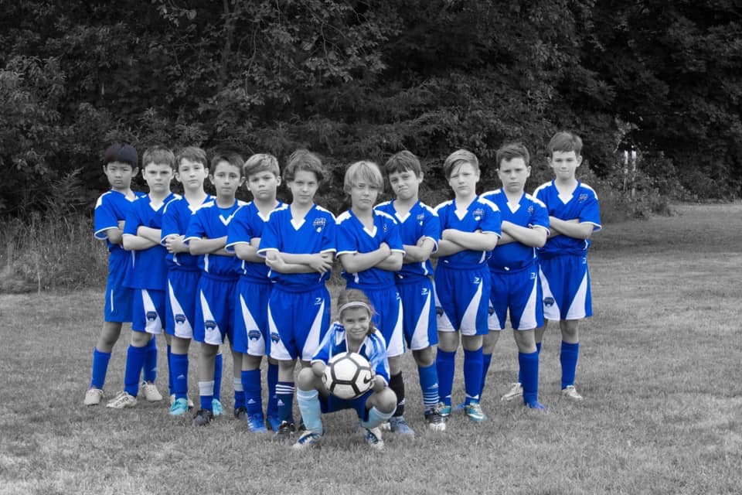
Equipment/Equipment Distribution
Equipment pick up is Thursday, September 2 from 4:00-6:00 PM at the Bedford Recreation Department (12 Mudge Way). Equipment pick up will be INSIDE. Please enter through the double green doors and come to the second floor.
Each team will receive hand sanitizer, sanitizing wipes and an electronic whistle. Each player will receive a pinnie that they should be given at the first practice. Pinnies should be taken home by players each practice and washed and brought to the next practice. Players can KEEP these pinnies at the end of the season.
Shared equipment should be sanitized after each use.

Slide 18
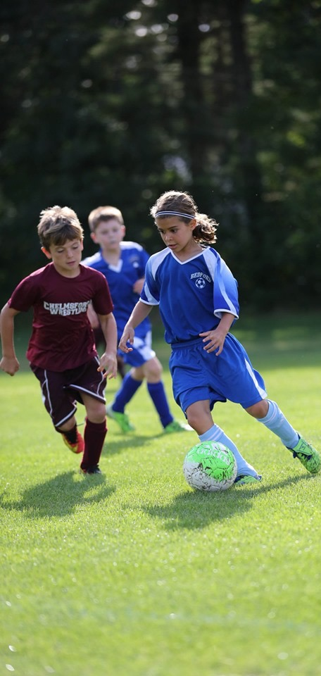
Coaching resources
Visit www.bedfordyouthsoccer.org for coaching resources
Nikki Taylor- Bedford Youth Soccer Liaison
Jason Rotella- Chair, Bedford Soccer Association
For weekend field closures/program cancellation due to weather please check our website at www.bedfordyouthsoccer.org
Age Group Coordinators (Grade 3-8):
Girls Grade 3: Kevin Dickert
Girls Grade 4: Jason Rotella
Girls Grade 5/6: Heath Luedde
Girls Grade 7/8: Kostia Franklin
Boys Grade 3: Heath Luedde
Boys Grade 4: Mary Gallant
Boys Grade 5/6: Sean Walton
Boys Grade 7/8: Damien Savoie

