Slide 1
Bedford Youth Soccer
Coaches Information

Slide 2
Agenda
Mission of Bedford Youth Soccer/Season Goals
Modifications made to the game
Field Spacing
COVID 19 Tracing and Procedures
Medical Release Form
Face Masks
CORI
Equipment/Equipment Distribution
Other Reminders
Coaching Resources

Slide 3
Fall 2020 Soccer goal:
Mission of Bedford Youth Soccer
Bedford Soccer's mission is to serve the children and achieve these goals:
1. All children can play. We provide opportunities for children of all skill levels to learn and
play the game.
2. Fun, learning, enjoyment. Having fun, learning and enjoying the game are always more
important than winning.
3. The game is the best teacher. Effective practice combines age-appropriate skill
development with time spent playing the game.
4. Sportsmanship and teamwork. Learning and demonstrating excellent sportsmanship and
teamwork are key parts of learning soccer.
5. Positive coaching. Coaching must always be positive, supporting children's enjoyment of
the game, strengthening children's self esteem and creating a positive environment.
6. Positive spectatorship. Parents and spectators play a crucial role in providing a positive
experience for the children. Positive spectators show respect for and appreciation of the
game, the coaches, and the players on all teams.
To build a healthy community by providing soccer to as many children as possible in a fun and safe environment.

Slide 4
Modifications made to the game:
NOT Permitted NO Heading NO Side Tackling NO Shoulder to Shoulder NO Throw Ins NO Corner Kicks NO Walls NO Drop Balls
What you CAN Do Block Tackle Kick Ins (no offsides, 10 yds) Corner Kick Ins (10 yes, cannot go into the penalty area. Punting Quick restarts
Balls should be sanitized if they touch player’s face or if hand touches face and then ball (goalie). Need a clean back up ball at the ready to swap in.

Slide 5
Field spacing
25 players max on field for practices or games
Teams must practice/play on standard size fields for their cohort.
Max of ONE spectator per player
Fields must be 14 feet apart (minimum)
Coaches must distance 6 feet from players at all times
Players should distance from each other when possible on the field.
No hand shakes, fist bumping
Spectators must remain 6 feet away from sideline to keep distancing from players and coaches.
Spectators must remain 6 feet away from other spectators at all times and wear a mask at all times.

Slide 6
COVID-19 Tracing and procedures
When a parent/guardian brings a child to practice/scrimmage each child MUST bring a signed monitoring sheet required by the Town of Bedford. If a child does not have a sheet they will not be permitted to remain at soccer. Coaches will be provided extra monitoring sheets in case they forget.
By signing the monitoring sheet the parent is agreeing that they will keep their child home if they had answered yes to any of the monitoring questions.
Each team should have a COVID-19 Coordinator and must take attendance at all events and keep this record through the season.
If a child, coach or spectator tests positive the COVID-19 coordinator should contact Nikki or Amy at the Bedford Recreation Department immediately who will contact the Bedford Board of Health.

Slide 7
Agreement for Symptom Monitoring for the Town of Bedford
*must be turned in once at the start of the season.
Forms will be emailed to parents before the start of the season.

Slide 8
Medical Release Form
*Coaches keep forms in their team bag all season.
Forms will be emailed to parents before the start of the season.

Slide 9
Face Masks
Facemasks must be worn by players at all times
Facemasks must be worn by coaches at all times
Facemasks must be worn by spectators at all times
The COVID-19 coordinator is responsible for making sure that all players/coaches/spectators are abiding by the facemask rules. If someone is in non-compliance the COVID-19 coordinator for that team should address the parent/spectator and if they do not comply the COVID Coordinator should contact the Recreation Department to report non-compliance.
Non compliance of facemask and distancing rules could result in suspension of field permits and program by the Town of Bedford.

Slide 10
CORI
Town of Bedford CORI form is required for all coaches/coordinators. CORI forms should be emailed to Nikki Taylor at ntaylor@bedfordma.gov

Slide 11
Grade 3-8 Field assignments
Grades 3-8
One weeknight & Saturdays
Week of September 28-Week of November 9
Age Group | Days/Times | Field Location
Girls Grade 3 | Mondays (6:00-7:30 PM) Saturdays (10:30-12:00 PM) | Springs Brook Park/VA1
Girls Grade 4 | Mondays (6:00-7:30 PM) Saturdays (11:45-1:15 PM) | Lane School Soccer
Girls Grade 5 | Mondays (6:00-7:30 PM) Saturdays (11:45-1:15 PM) | Davis School
Girls Grade 6-8 | Mondays (6:00-7:30 PM ) Saturdays (10:30-12:00 PM) *Grades 6-8 have been combined due to numbers. | Mondays: BHS TURF Saturdays: South Road Fields
Age Group | Days/Times | Field Location
Boys Grade 3 | Tuesdays (6:00-7:30 PM) Saturdays (2:30-4:00 PM) | Springs Brook Park/VA1
Boys Grade 4 | Tuesdays (6:00-7:30 PM) Saturdays (2:30-4:00 PM ) *Due to numbers grade 4 boys will be combined with grade 3 boys. | Springs Brook Park/VA1
Boys Grade 5 | Tuesdays (6:00-7:30 PM) Saturdays (1:00-2:30 PM) | South Road
Boys Grade 6-8 (combined group due to numbers) | Tuesdays (6:00-7:30 PM ) Saturdays (2:45-4:15 PM ) *Grade 6 will practice as a group and Grade 7 & 8 will practice as a group. Grades will combine for scrimmages due to numbers. | BHS Turf/Liljegren Field

Slide 12
Grade K-2 Field assignments
Grades K-2
Saturdays
October 2-November 14
Age Group | Days/Times | Field Location
Girls Grade K | Saturdays, 10:45-11:45 AM | Plateau Field (JGMS)
Boys Grade K | Saturdays, 10:45-11:45 AM | J Field (JGMS)
Girls Grade 1 | Saturdays, 12:30-1:45 PM | Plateau Field (JGMS)
Boys Grade 1 | Saturdays, 12:30-1:45 PM | J Field (JGMS)
Girls Grade 2 | Saturdays, 8:45-10:15 AM | Plateau Field (JGMS)
Boys Grade 2 | Saturdays, 8:45-10:15 AM | J Field (JGMS)
*Specific location for each team is assigned. Please see the attached map. Please do not cross into other teams playing fields. Use the perimeter of the field to access your playing space.

Slide 13
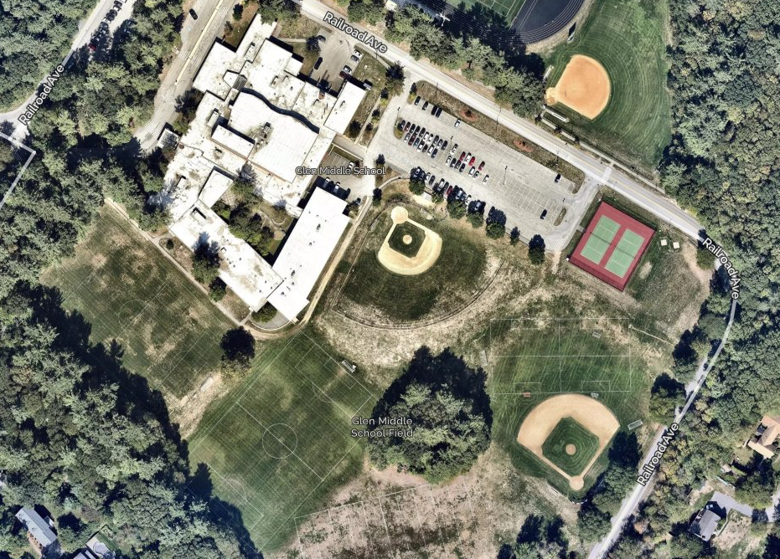
Intramural (Grade K-2) Playing Field Assignment Map
Girls Team 3
Girls Team 3
COVID guidelines dictate that fields be set up in a certain way. All fields must follow this guideline and each field must be 14 feet from a neighboring field.
Girls Team 2
Girls Team 1
Boys Team 1
Boys Team 3
Boys Team 2
Boys Team 4

Slide 14
Equipment/Equipment Distribution
GRADE 3-8:
Equipment pick up is Saturday, September 26 from 9:00-10:00 AM outside of 12 Mudge Way (Recreation Department)
Grade K-2:
Equipment pick up is Friday, October 1 from 5:00-6:00 PM outside of 12 Mudge Way (Recreation Department)
12 Mudge Way will be closed the entire season. If you cannot make these pick up tiemse pleaes contact Nikki Taylor. If you need equipment replenished please contact Nikki Taylor at the Bedford Recreation Department.
Each coach will receive hand sanitizer and sanitizing wipes in their equipment bag.
Each player will receive a pinnie that they should be given at the first practice. Pinnies should be taken home by players each practice and washed and brought to the next practice.
Shared equipment must be sanitized after each use.
Benches should not be used this season.

Slide 15
Other reminders
Playing time for scrimmages must be equal for all players.
Players must have equal playing time in all positions. We are a town program, not a club program.
Communication with parents throughout the season is key.
Attitude: players follow the coaches example when it comes to attitude
Players must practice positive sportsmanship at all time. Please set this expectation from the first practice.
Take care of the fields. Move the goals out of the goal boxes for practices.
Players may not wear jewelry
Weather cancelation:
By 7:00 AM (morning sessions)
By 11:00 AM (afternoon sessions)
If there is a weather cancellation it is the coaches responsibility to notify their players.

Slide 16
Coaching resources
Visit www.bedfordyouthsoccer.org for coaching resources
Nikki Taylor- Bedford Youth Soccer Liaison
Jason Rotella- Chair, Bedford Soccer Association
For weekend field closures/program cancellation due to weather please check our website at www.bedfordrecreation.org
Intramural Coordinators:
Intramural Coordinators
Kevin Dickert
Jay Hadden
Damien Savoie
Age Group Coordinators (Grade 3-8):
Girls Grade 3: Jason Rotella
Girls Grade 4: Kevin Dickert
Girls Grade 5: Kostia Franklin
Girls Grade 6-8: Tara Capobianco
Boys Grade 3: Annemarie Silver
Boys Grade 4: TBD
Boys Grade 5: Mary Gallant
Boys Grade 6-8: Sean Walton

